Slide 1
Does a company’s performance impact the CEO’s salary?
Group 4

Slide 2
Introduction

Slide 3
Data

Slide 4
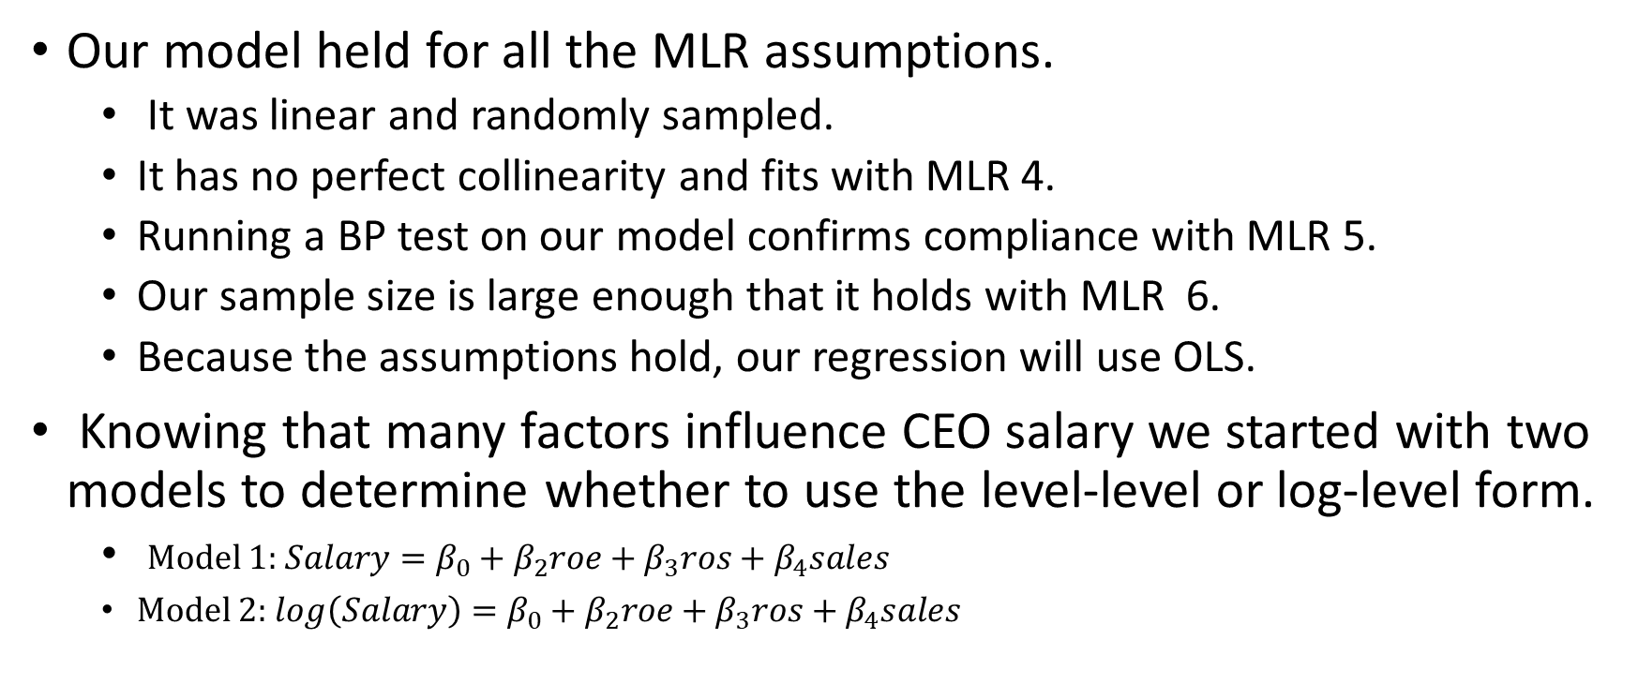
Empirical framework pt. 1
Our model held for all the MLR assumptions.
It was linear and randomly sampled.
It has no perfect collinearity and fits with MLR 4.
Running a BP test on our model confirms compliance with MLR 5.
Our sample size is large enough that it holds with MLR 6.
Because the assumptions hold, our regression will use OLS.
Knowing that many factors influence CEO salary we started with two models to determine whether to use the level-level or log-level form.
Model 1: $Salary=β_{0}+β_{2}roe+β_{3}ros+β_{4}sales$
Model 2: $log\left(Salary\right)=β_{0}+β_{2}roe+β_{3}ros+β_{4}sales$

Slide 5
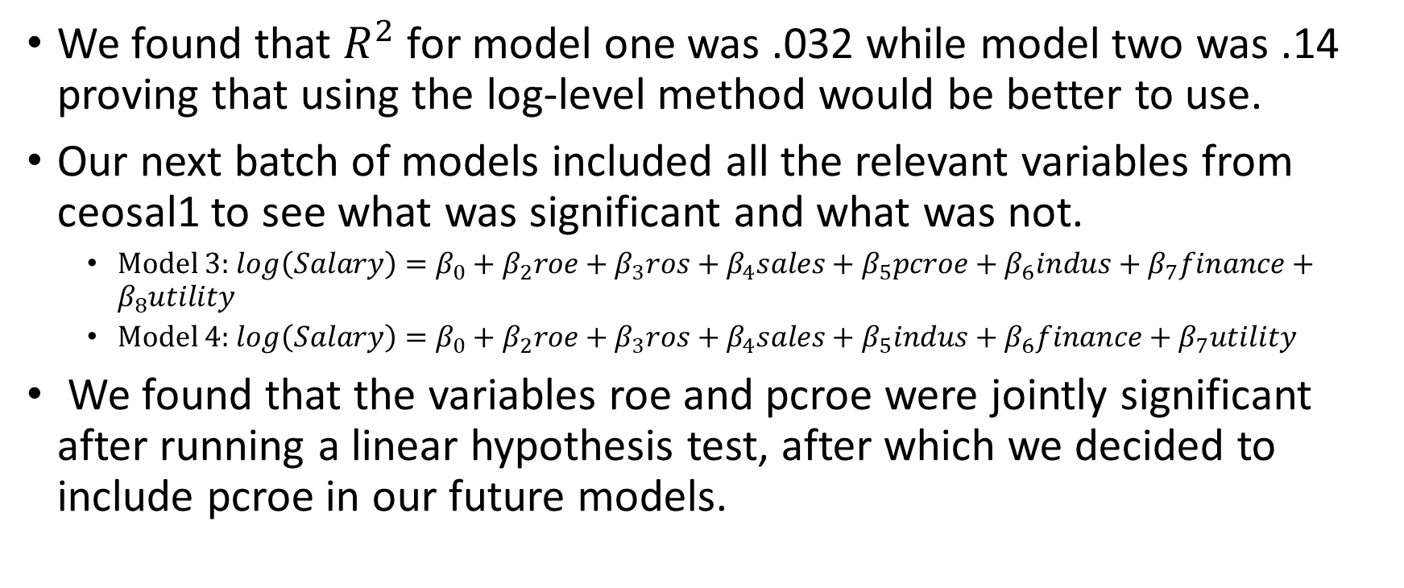
Empirical framework pt. 2
We found that $R^{2}$ for model one was .032 while model two was .14 proving that using the log-level method would be better to use.
Our next batch of models included all the relevant variables from ceosal1 to see what was significant and what was not.
Model 3: $log\left(Salary\right)=β_{0}+β_{2}roe+β_{3}ros+β_{4}sales+β_{5}pcroe+β_{6}indus+β_{7}finance+β_{8}utility$
Model 4: $log\left(Salary\right)=β_{0}+β_{2}roe+β_{3}ros+β_{4}sales+β_{5}indus+β_{6}finance+β_{7}utility$
We found that the variables roe and pcroe were jointly significant after running a linear hypothesis test, after which we decided to include pcroe in our future models.

Slide 6
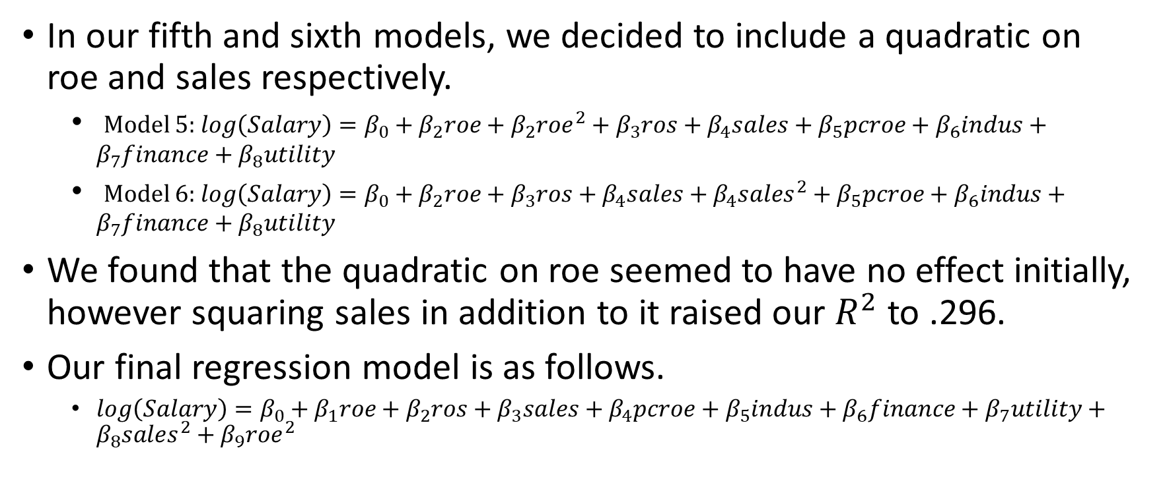
Empirical framework pt. 3
In our fifth and sixth models, we decided to include a quadratic on roe and sales respectively.
Model 5: $log\left(Salary\right)=β_{0}+β_{2}roe+β_{2}roe^{2}+β_{3}ros+β_{4}sales+β_{5}pcroe+β_{6}indus+β_{7}finance+β_{8}utility$
Model 6: $log\left(Salary\right)=β_{0}+β_{2}roe+β_{3}ros+β_{4}sales+β_{4}sales^{2}+β_{5}pcroe+β_{6}indus+β_{7}finance+β_{8}utility$
We found that the quadratic on roe seemed to have no effect initially, however squaring sales in addition to it raised our $R^{2}$ to .296.
Our final regression model is as follows.
$log\left(Salary\right)=β_{0}+β_{1}roe+β_{2}ros+β_{3}sales+β_{4}pcroe+β_{5}indus+β_{6}finance+β_{7}utility+β_{8}sales^{2}+β_{9}roe^{2}$

Slide 7
Results

Slide 8
Conclusion

